Slide 1
WA4 – Web APIs w/ AJAX
COMP 256 – Dickinson College
Prof. Braught
Spring 2023

Slide 2
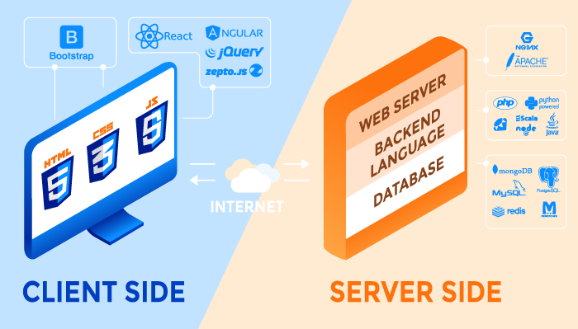

Typical Elements of a Web Application
http
https
Front
End
Web APIs
Back
End
Image from: https://rubygarage.org/blog/technology-stack-for-web-development
Notes:
Today we’ll look at WebAPIs
- recall that these are one of the ways in which the front end communicates with the back end.
- Once we have loaded a page
- The page may need additional information from the server
- E.g. like when you scroll down and more and more things appear in a feed…
- That new information is added, by JavaScript code
- It makes an API request to the server to ask for the information it needs.
- Then it creates and adds new elements to the DOM as we saw last time.
- The browser then renders those new elements and they appear in your page.
Demo the end point for today’s class period (api1.js)
- This page makes a call to the OpenWeather API
- It uses the information it gets back to set the temperature
- Does it in Kelvin… (not particularly useful… but it’s the default… you’ll do better in the homework).
- This is linked in the container as api1.html
== Source ==
<html>
<head>
<title>AJAX Demo</title>
<script>
function getWeather() {
var req = new XMLHttpRequest();
req.open("GET", "https://api.openweathermap.org/data/2.5/weather?q=17013,us&appid=71600e803223b59828cade9d4fc4d46b", true);
req.onreadystatechange = function() {
if (this.readyState == 4 && this.status == 200) {
let resp = JSON.parse(this.responseText);
let temp = document.getElementById("temp");
temp.innerHTML = resp.main.temp;
}
};
req.send();
}
</script>
</head>
<body>
<h1>Weather API</h1>
<ul>
<li>Temperature: <span id="temp">Unknown</span> Kelvin.</li>
</ul>
<input type="button" onclick="getWeather()" value="Get the Weather">
</body>
</html>

Slide 3
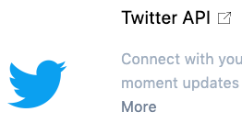









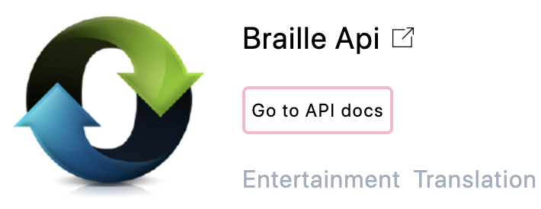
API: Application Programming Interface
API Examples (https://apilist.fun):
Notes:
API – Application Programming Interface
- APIs are protocols by which front end code can request data from back end services.
- APIs are also application specific:
- Each API will define the particular types of requests that can be made
- The things you can request from the Twitter API are different from those you can request from the Braille API
- Each API will also define exactly the format and content of the data that it will return for each type of request.
- We’ll see some of that in a bit.
There are tons of API’s out there…
- One or multiple for pretty much anythign you are interested in.
- Explore the apilist.fun site a bit and find one of interest.
- What does it do?

Slide 4

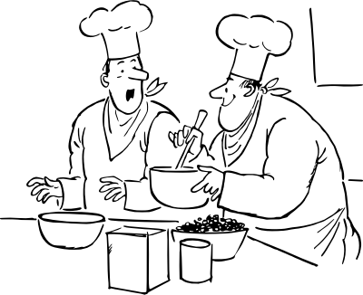



Web API Metaphor
Notes:
We can think of an API like a menu in a restaurant
- there is a menu that is presented
- The menu describes the types of requests (API calls) that can be made by the client (customers)
- the request is sent to the back-end server
- done via the waitstaff in the restaurant
- done via libraries and HTTP over the internet for a web api
- The server generates a response
- The kitchen staff make the dish that was ordered
- A back-end application program runs and generates the response on the server side.
- The response is delivered back to the client.
- The wait staff delivers the requested meal.
- again, done via the internet, HTTP and software libraries for a web-api.
Note that this will be an abstraction:
- In the restaurant
- You think about what you want, make the request and then consume the meal.
- You don’t think about:
- how your order gets to the cooks,
- who is making your meal, how they are making it, where the ingredients came from
- how the final meal gets back to you.
- you can ignore all of those details.
- With a Web API
- You create a request (using the ”menu” that the API provides)
- You will send it off
- Then you will get a response and use it in your page.
- You think about what you want and how to form the request.
- You don’t think about how the request gets to the server, what the server does, where it gets the data or how the response gets back to you.

Slide 5

Web API Example – URL, Host, Path, Query String
https://api.openweathermap.org/data/2.5/weather?q=17013,us&appid=71600e803223b59828cade9d4fc4d46b
Path,
Endpoint,
Service
Host
Query String
Notes:
Requests are made to API’s via a URL
- The url is all one long line, no line breaks, just doesn’t fit that way on this slide.
The URL for an API request can be broken into several parts:
- Host:
- the server to which the request is to be sent
- Note: For big heavily used APIs (e.g. Google, YouTube, Instagram, etc), this is actually many many servers that divide the work.
- In our metaphor:
- the host is the restaurant at which you are dining.
- Path or Endpoint or Service (all mean the same thing and you’ll hear all of them from different sources).
- the specific service on the host that we are making the request for.
- here it is data/2.5/weather
- can have multiple / and words
- The server defines the endpoints
- If you dig into the documentation on apilist.fun you’ll see that each specify their endpoints.
- A given host may offer multiple endpoints for different services
- For example:
- Google Maps offers both just a map and also driving directions.
- Those would likely come from different endpoints
- In our restaurant metaphor:
- A request for a drink would go to the /bar endpoint
- A request for a meal would go to the /kitchen endpoint
- A request for the bill would go to the /cashier endpoint
- Query String:
- Provides additional information that is needed by the endpoint to process the request.
- The query string is separated from the path by a ?
- everything after the ? Is the query string.
- the ? Is not part of the query string.
- The query string is simply passed onto the backend application that handles the request.
- That program will decide what to do with the the query string.

Slide 6
Web API Example – Query Parameters
https://api.openweathermap.org/data/2.5/weather?q=17013,us&appid=71600e803223b59828cade9d4fc4d46b
Query
Parameters
Notes:
There is some structure to the Query String.
It may contain one or more Query Parameters.
- Each query parameter tells the endpoint something it needs to know.
- Here we have:
- q=17013,us
- This is the zipcode (us) or postcode or other location specifier for where we want the weather.
- appid=7160…d46b
- this is a long hexadecimal number
- more on that in a minute…
- In our metaphor the query string would be:
- The particular drink that you ordered from /bar
- E.g. /bar?drink=scotch&age=18
- The particular meal that you ordered from /kitchen
- E.g. /kitchen?pasta=rigatoni&sauce=marinara,
Here the query parameters are separated by &
- This is a common convention used by many API services.
- However, it is not universal
- Recall that the whole query string is passed to the endpiont or service.
- It is up to that service to decide how to process the query string.
- so different services or endpionts may use different conventions for dividing query parameters.
- you have to use the documentation for the API to know how to build the query string and what it can or must contain.
- The query string is passed unchanged to the back-end application program to process.
- This is kind of like the browser passing arguments to a function that is running on the server.

Slide 7
Web API Example – Fields, Values, Keys
https://api.openweathermap.org/data/2.5/weather?q=17013,us&appid=71600e803223b59828cade9d4fc4d46b
Field
Value
API Key
Notes:
The Query Parameters can be further subdivided into:
- Fields:
- These are the names of the parameters
- q
- appid
- Values:
- The value associated with the parameter.
- 17013,us
- 97600….46b
Unlike passing parameters in a program where we just pass the value here you give the name and the value.
This has 2 benefits:
- They can be listed in any order
- Easily allows for optional query parameters to simply be omitted.
The appid field for the Weather API is called an API KEY
- Lots of APIs require keys
- An API key is an identifier so that the API knows who is calling it.
- You register for a key with the API provider
- Many are free for development
- The key lets them rate limit your use.
- If / When you want to use the API a lot or deploy an app used by others
- Then you often have to pay the API provider for a commercial key
- Having a key let’s them know who to bill for the service and how much to bill them based on use.
We have now seen this idea of key / value pairs a ton now.
- should be starting to see them all as the same thing.
- Map : HashMap (Java) : Dictionary (Python) : etc…
- Attributes (HTML), properties (CSS), names, Fields, keys etc…
- these really are all the same thing…

Slide 8
API Request Responses
Different Services will use different formats:
Text – plain text
HTML – HTML source code
XML – Extensible Markup Language
JSON: JavaScript Object Notation
Notes:
When we make a request, the server will send a response back to us.
The format in which that response will come depends upon the service that we are talking to.
There are a few very common formats:
- Plain text – the server just essentially returns an ASCII or Unicode string.
- HTML – the server returns an HTML page
- XML – Extensible markup language
- A language like HTML that uses tags to apply semantic meaning to the content
- The tags are custom and are defined by the application.
- JSON – Java Script Object Notation
- A way of expressing an object (i.e. fields and values) as a text string.
XML was the dominant format of API responses for a long time.
Now JSON has taken over much of that because a lot of API call are from JavaScript so having responses as JavaScript Objects makes them easier to process.
In this course we’ll be dealing exclusively with JSON.
- I know that some of the DATA courses cover some other formats including XML.

Slide 9
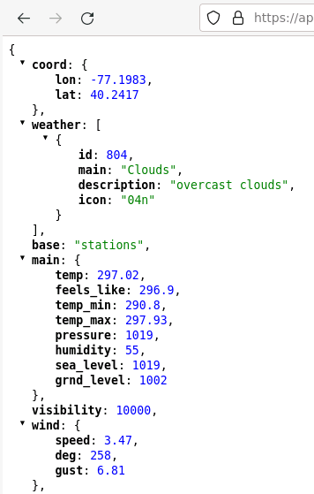
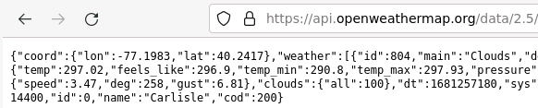
Raw & Parsed JSON
Parsed
JSON
Raw JSON
Notes:
If you place an appropriate API request URL in a browser that does not have an extension for displaying JSON we see the RAW JSON response.
e.g. Copy and paste the following URL into the browser:
- https://api.openweathermap.org/data/2.5/weather?zip=17013&appid=71600e803223b59828cade9d4fc4d46b
What is displayed looks like a bunch of messy text.
- This is the Raw JSON
- If we look through it we can make out some information
- ”Clouds”
- ”temp”
- etc…
But we can also “Parse” that text into a nicer format
- that will let us see more clearly what it represents.
- instructions for installing the parser extension in your browser appears in the activities.

Slide 10
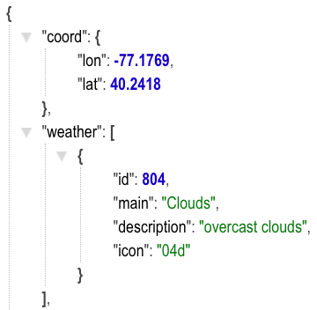
JavaScript Objects (parsed JSON)
Notice that the whole response is also an object.
Objects:
A value in {…} is a JavaScript object, which is made up of fields.
Fields:
Key: Value pairs in an object are called fields.
Arrays:
A value in
[ ... ] is a JavaScript array.
…
Notes:
Let’s dig into the parsed JSON and understand how JSON represents objects.
The JSON is make up of key:value pairs
- Key “lat” has the value 40.2418
- Key description has the value “overcast, clouds”
For some Keys the value is an object:
- Key ”coord” has an object as its value
- The { … } indicate that the value is an object.
- So the fields lon and lat are in the object associated with coord.
For other keys the value is an array:
- The key “weather” has an array as it value
- the [ … ] indicate that the value is an array.
- The “weather array has just one element
- and that element is an object.
- we can tell because it is in { … }
- If there were multiple elements in the array they would be separated by commas.
There is also a { at the start and … if the rest of the response was shown there would be an } at the end.
- So the entire thing is an object.
- In our code the key for that whole object will usually be called resp for response.

Slide 11
Referencing Fields in JavaScript Objects (i.e. in Parsed JSON)
We access values using standard dot and array notation.
resp
resp.coord.lon
resp.weather[0].main
Notes:
We will use the JSON responses we get back to create an Object in our JavaScript code.
- When we do so, we will have a reference to that object like we have references to any object.
- For now, we’ll assume that the name of that reference is “resp” (short for response).
- In a program of course the name of the name of this reference can be whatever we name the variable.
- Though resp is a pretty good choice.
Now we can access the values in the object using standard dot and array notation.
For example
- to get the value of the “lon” field we would use:
- resp.coord.lon
- coord is in the object referred to by resp
- then lon is in the object referred to by coord
- so resp dot cood dot lon (resp.coord.lon) refrences that field and has the value -77.1769
- to get the value of the “main” field we would use:
- resp.weather[0].main
- Same reasoning to get weather…
- but the value of weather is an array
- so we then need to use an index to get the element we want.
- so [0] - since there is only one element in this array.
- then withing resp.weather[0] we need the field main
- so add .main
- that gives: resp.weather[0].main which has the value “Clouds”
Seems odd to have an array with one element, but it is common in API responses.
So, why is there an array for weather if it only has one element in it?
- Good question….
- But if I had to guess there are other query parameters that will give a list of these objects.
- maybe one for morning , afternoon, evening?
- or hourly?
- Or you might imagine a second element with secondary weather conditions
- E.g. Windy to represent a cloudy and windy day.
- You can explore the entire OpenWeather API here:
- https://openweathermap.org/current#current_JSON

Slide 12
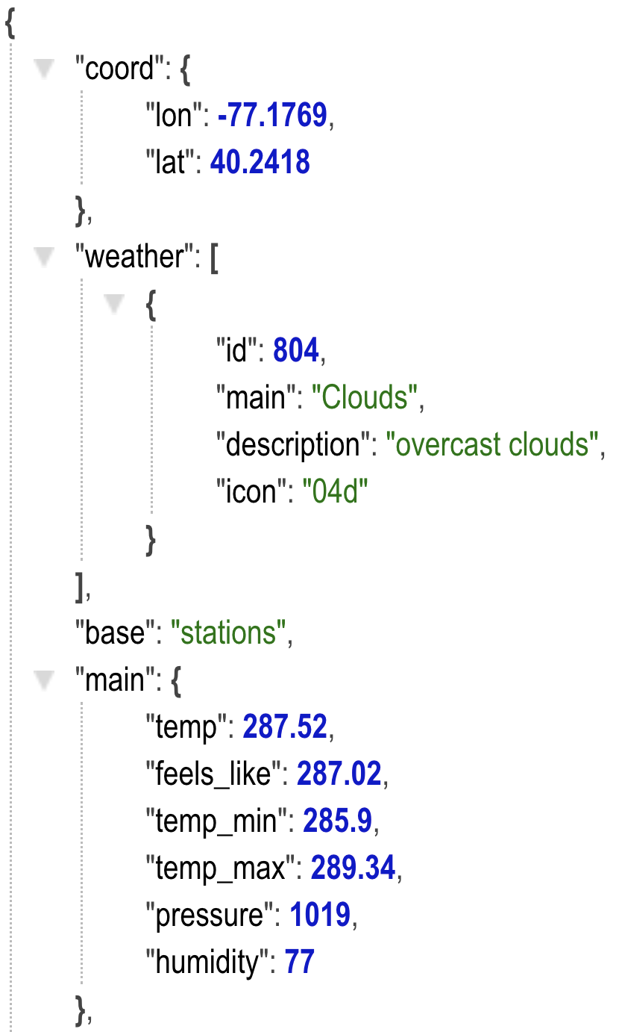
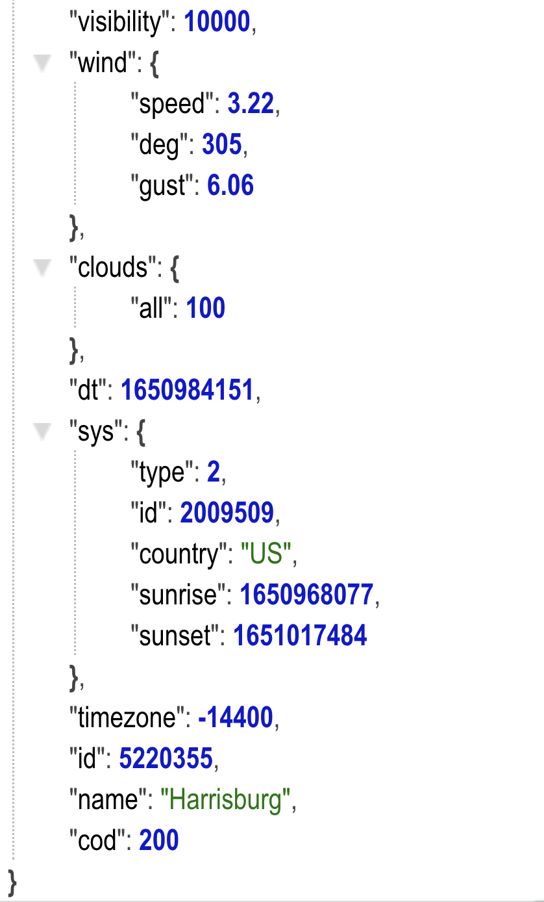

Referencing Fields in JSON
resp
How would you reference the values of the following fields:
city name
humidity
wind speed
icon

Slide 13

Calling APIs with AJAX
∅
∅
AJAX
Asynchronous JavaScript and XML
XML – eXtensible Markup Language
Built in JavaScript technology for making API calls.
Notes:
AJAX – Stands for Asynchronous JavaScript and XML
- Not to be confused with the cleaning product
- Nor with the Amsterdam Football team.
It is the name of the technology built into JavaScript for making API calls.
- Invented when XML responses were dominant
- So XML got baked into the name.
- It is a bit of a misnomer now, and AJAX is used to get JSON responses too.

Slide 14
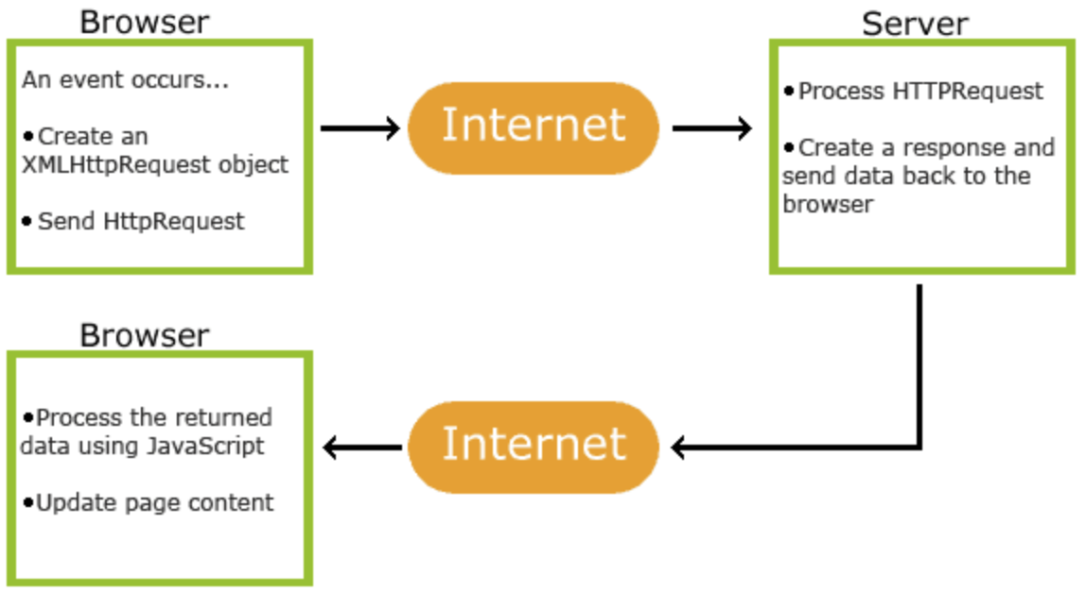
Making API Requests with AJAX
Front-End
Back-End
AJAX
Notes:
The Process for making an API request using AJAX is typcially:
- An event occurs
- e.g. a user clicks on a button
- That will run a JavaScript function (just as we saw last time)
- That function will:
- create a Special JavaScript object called an XMLHttpRequest
- That object knows how to send the API request over the internet to the server.
- Use the object to send the request.
- Then it sits and waits…
- While it is doing that the JavaScript program continues on doing its thing…
- This is why it is called asynchronous.
- When the response eventually returns
- Code that we write will run and process the response.
- It will parse the JSON into an object
- use the dot and array notation to find the values we want
- use those value to update the page as necessary.
So back to your scrolling feed
- when you scroll down and are almost to the bottom… (event)
- The code makes an API request to the server for more items
- The code then waits
- asynchronously so the app can do other things…
- When the response comes back
- code updates the page to add the new items to the bottom of your feed.

Slide 15
Making an API Request with AJAX
function requestSometing() {
var req = new XMLHttpRequest();
req.open("GET", "REQUEST_URL", true);
req.onreadystatechange = function() {
if (this.readyState == 4 &&
this.status == 200) {
let resp = JSON.parse(this.responseText);
// Code that updates the page goes here.
}
};
req.send();
}
Notes:
To make an API request with AJAX you will write a function.
- a lot of it is template code that has to be there.
- I’ll tell you what it is…
- but key is that you only need to change the parts in red
The main points are:
- Give your function a meaningful name (don’t call it “requestSomething”, call it getWeather, etc).
- Create an XMLHttpRequest object – this object is built into JavaScript for making API requests.
- Call the open method on the request object.
- Like opening a file before you can write to it.
- Need to open the request before we can send it.
- GET means we want to get some information
- There is also POST and a few others for sending information.
- Define a function that will be called later when the response returns.
- This code does not run now!
- It is called automatically for us (in a separate thread) when when the response arrives.
- Invoke the send method on the request to send it to the server.
- When the response arrives some time later…
- the code in the function assigned to req.onreadystatechange will run.
- Check that the request was successful.
- readyState 4, means the request is complete
- status 200 means it was successful
- If the request was successful
- Parse the JSON and set resp as a reference to the resulting object.
- Use the contents of the object to update the page.
- Other readyState and status values have other meanings:
- E.g. status 404 means page not found
- E.g. status 401 means unauthorized

Slide 16
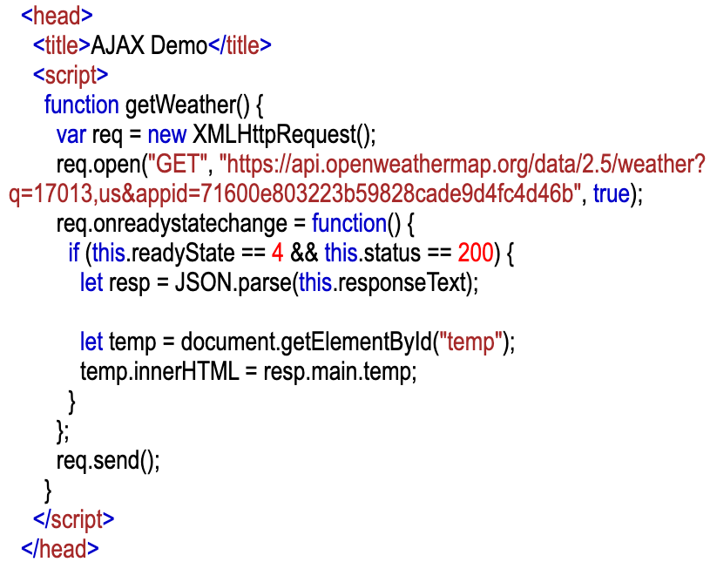
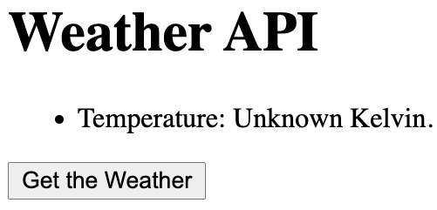
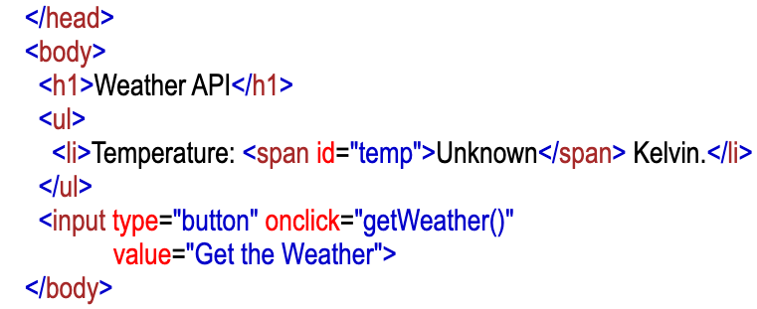
Calling the OpenWeather API
Notes:
Here is what that looks like when we use it to get the temperature from the OpenWeather API.
Here is what is happening in this page in order of the animations, which matches the order in which things occur in the use of the page.
The input element of type button:
- is rendered in the page as the “Get the Weather” button.
- when this is clicked, the click event will invoke the getWeather() function.
The getWeather() function:
- creates a new XMLHttpRequest object.
- opens it with
- A “GET” request which is typical for requesting information.
- The URL with the query string including parameters and values for
- the zip code 17013,us (Carlisle)
- and an appid with the API key
- Note: I registered this API key and it should be sufficient for all of us to use.
- In general however, everyone should have their own API key.
- assigns the onreadystatechange function to be a JavaScript function that will run later when the request completes.
- calls send() to send the URL request.
Some time will pass while
- the request is sent to the server
- the server runs an application program that generates a response
- the response is returned to our machine.
When the response returns
- The function assigned to onreadystatechange is called automatically and asynchronously.
- This code checks to be sure
- the state is 4 (complete)
- the status is 200 (success)
- Then it processes the response
- It parses the JSON response into a JavaScript Object
- Then it gets the span element where the temperature should be placed
- using getElementById(“temp”)
- It then uses the data in the response (resp.main.temp) to set the content of the span tag.
The browser will then re-render the page to include the new content of the span tag.

Slide 17



Frameworks and Libraries as Abstractions
Notes:
Now, as we saw it the code to make the request and update the page has a lot of boiler plate code.
If you develop web apps using standard JS and AJAX then there will be lots and lots of that type of code.
It is somewhat annoying to write that code.
So various frameworks have been created to
- reduce the pain in writing repeated boilerplate code
- help to organize code in more efficient and maintainable ways.
You may have heard of some of these:
- React, Angular, Vue
- All general frameworks for building apps.
Axios
- simplifies the process of making and processing API requests.
They are all just libraries of objects and functions written using JS and AJAX
- They hide some of the annoying details
- Letting you focus on the important stuff for your application.
- They are abstractions!

Slide 18

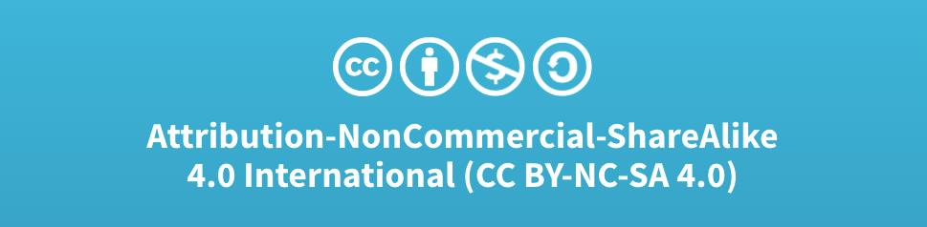
Acknowledgments
Slide Template From:
https://creativecommons.org/licenses/by/4.0/
Slide Content Licensed as:
Creative Commons Attribution-NonCommercial-ShareAlike 4.0 International License.
Notes:
Note: Individual images may be covered by their own licensing agreements and were incorporated here under fair use. Their use in this slide deck does not change or alter their licensing.

Slide 19
Web API Example – Server, Service
Server
https://api.openweathermap.org/data/2.5/weather?q=17013,us&appid=71600e803223b59828cade9d4fc4d46b
Service
Notes:
Endpiont can be broken into two parts:
- server - api.openweathermpa.org
- service – data/2.5/weather
- a back-end program that is run by the server to process the request.
- server – the name of the web server to send the request to.
- may also hear ”domain”
- Like the restaurant
- service – the specific thing you are asking for from that server.
- Like asking ordering from the bar, the appetizers or the mains
- Each service is a essentially a back-end program that is run by the web server
- The service generates the response and the server returns it to you.

